Slide 1
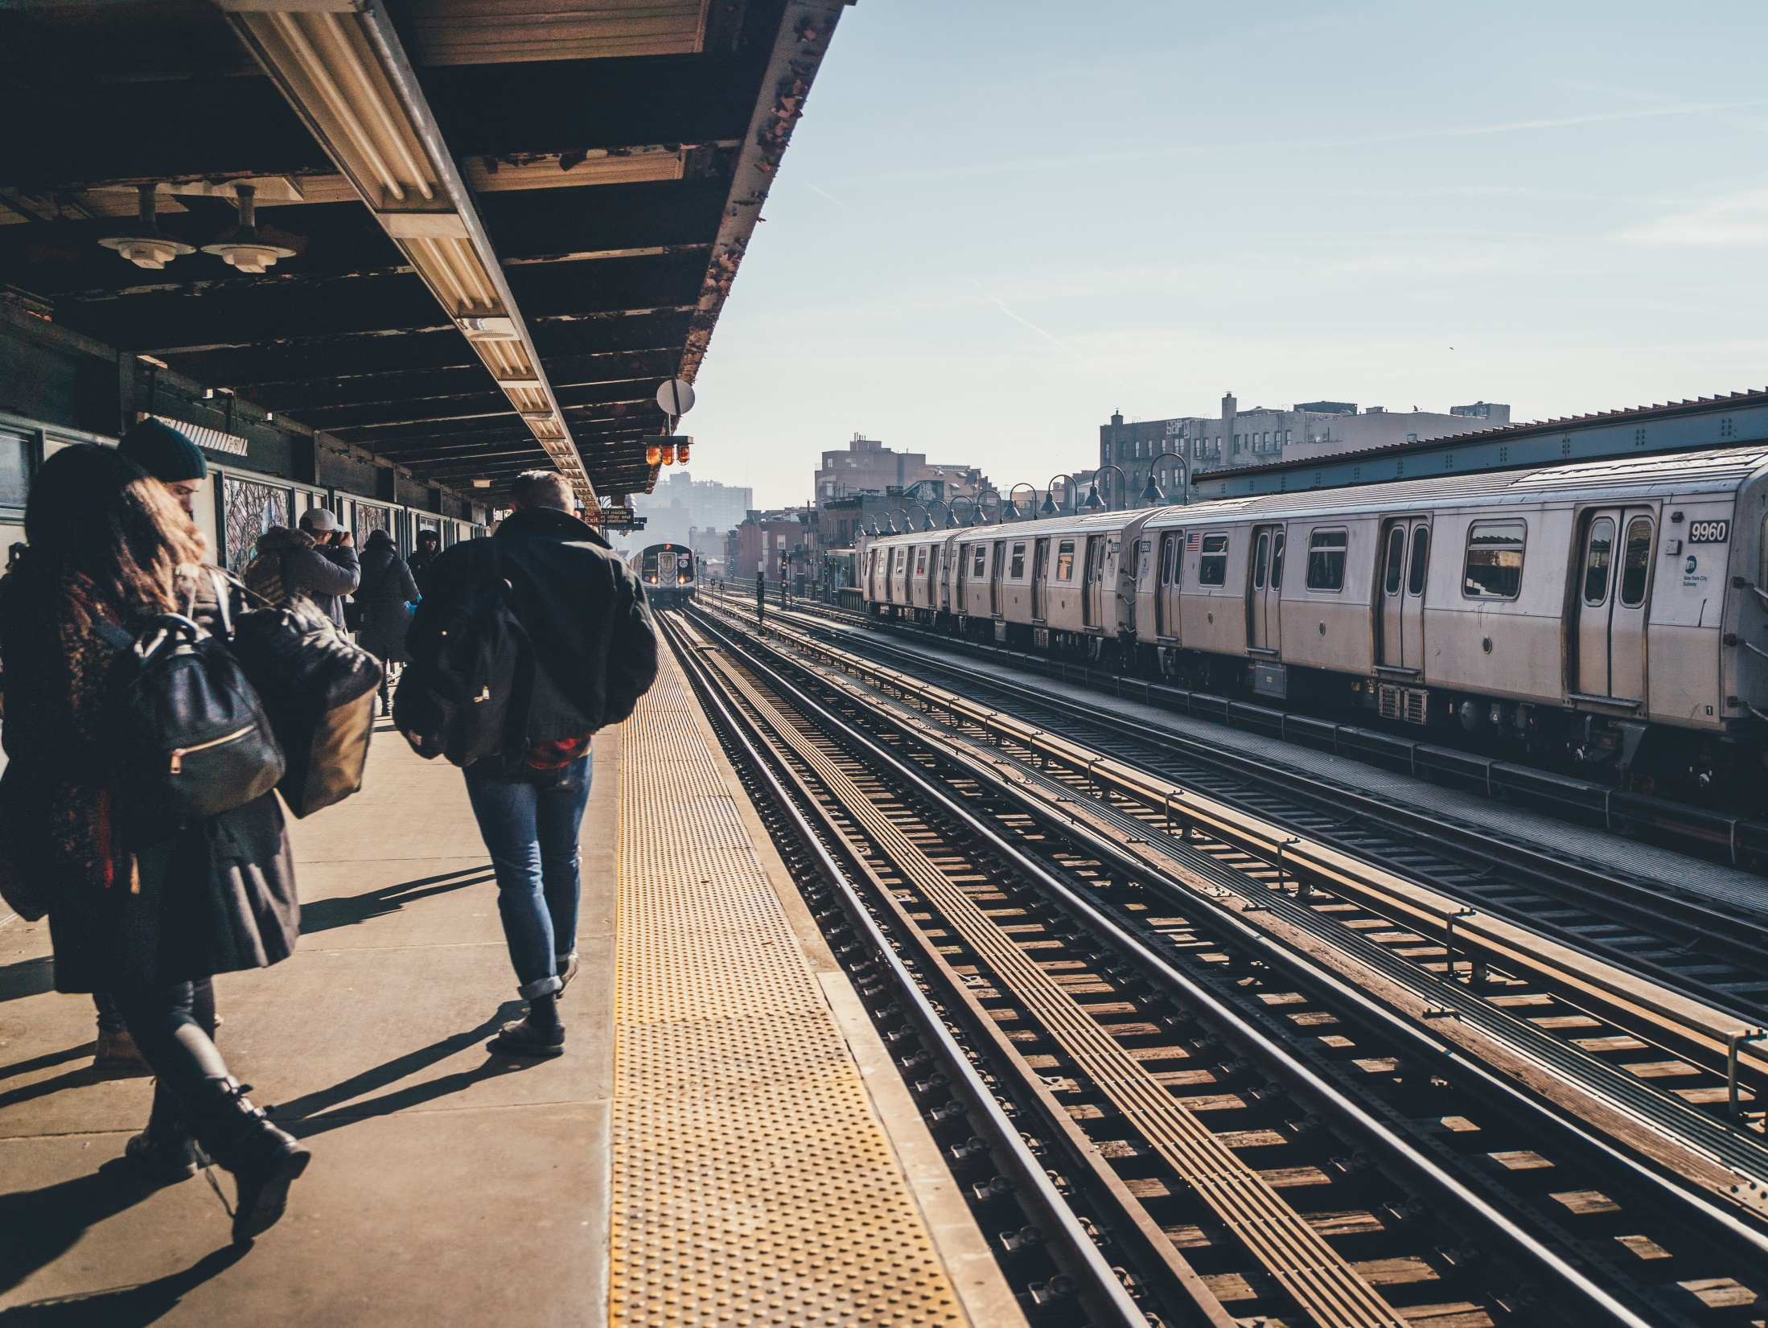


PROJECT 1:
WTWY STREET TEAMS PROPOSAL
SGP2020_DSQ3

Slide 2

The Goal:
WTWY street teams wants obtain the most email signups for their annual OMGYN Gala in NYDC.

Slide 3
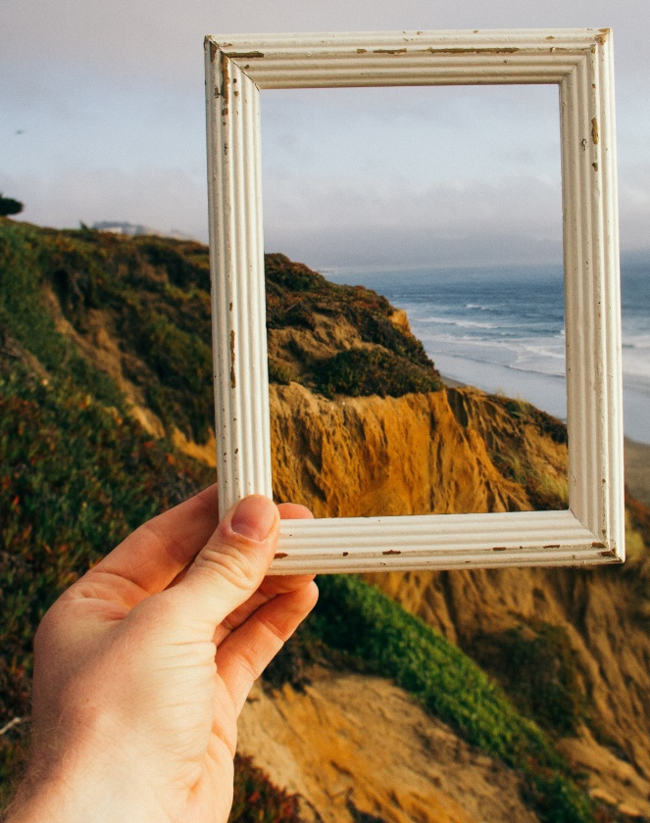
The Question:
When and Where to deploy WTWY’s resources to achieve their goals?

Slide 4
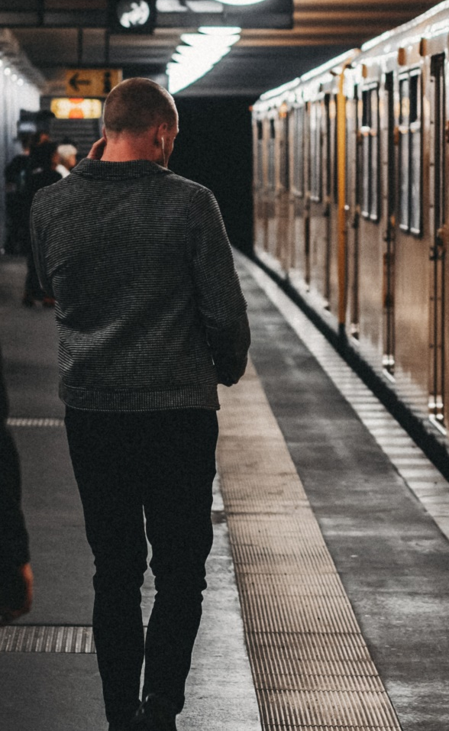
Information source:
MTA 29th August 2020 Turnstile Data
http://web.mta.info/developers/data/nyct/turnstile/turnstile_200829.txt
Data Set Summary:
Number of Days : 7
Total number of commuters : x.x Mi
Number of Stations : xx
Busiest Station : xx , Date, Time

Slide 5
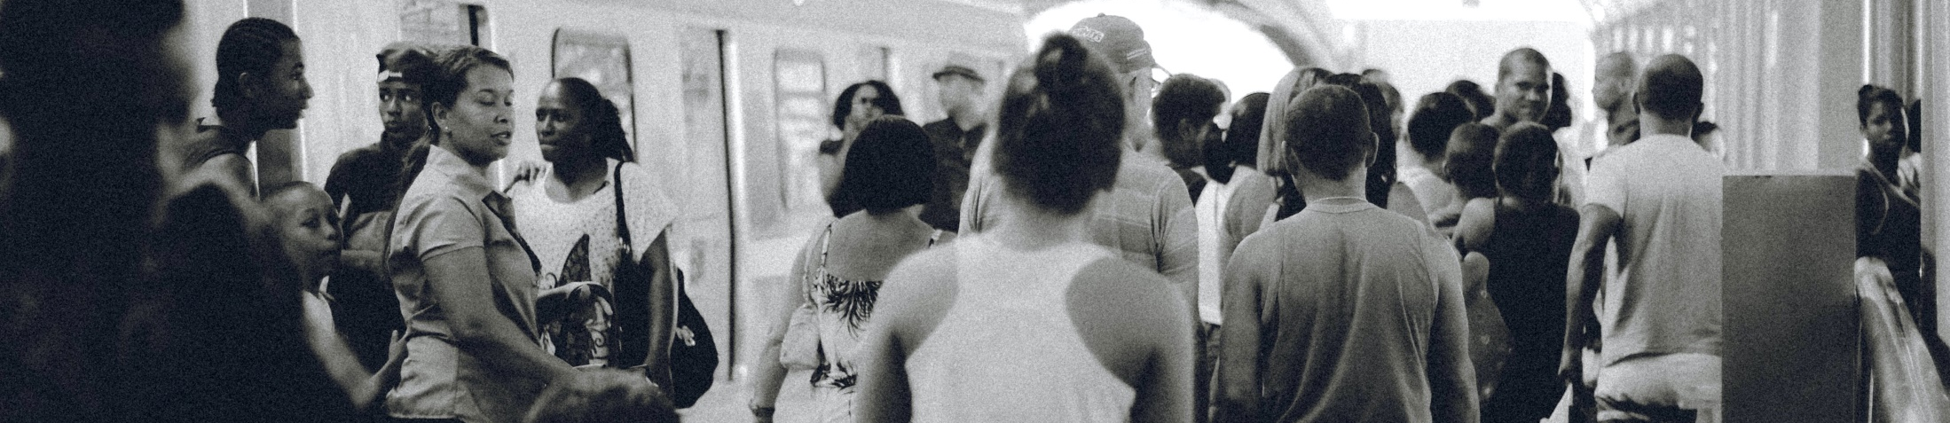
Our Assumptions:
All Commuters are Adults suitable for Email Signup
Both Incoming and Outgoing Traffic to the stations are targeted
Timeslots are 4 hourly

Slide 6
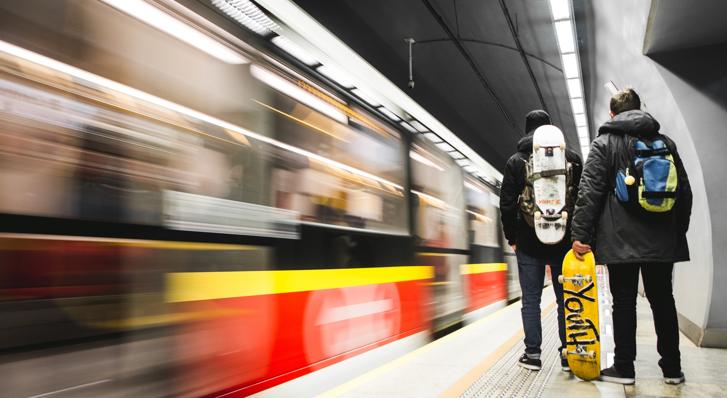
Top 5 Stations:

Slide 7
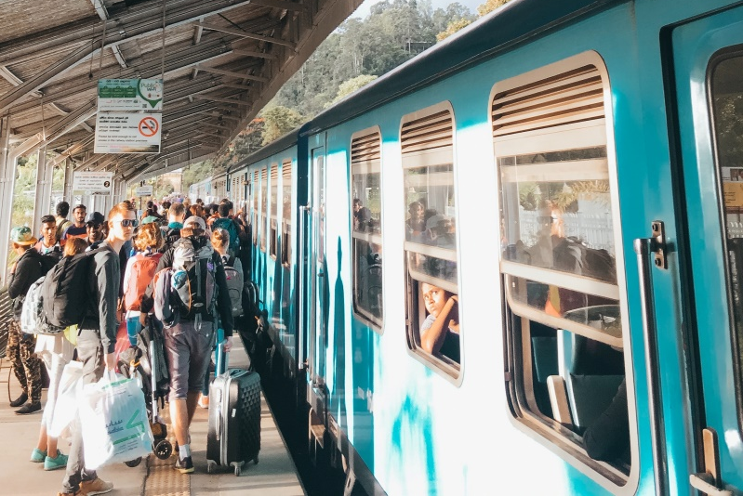
Top 3 Weekday Volume

Slide 8
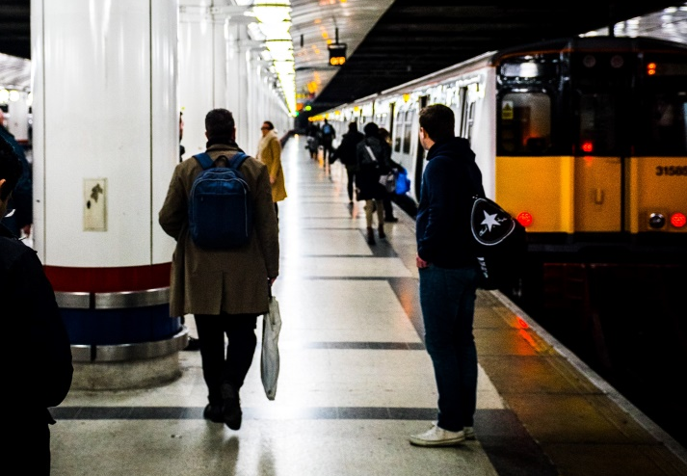
Top Weekend Volume

Slide 9
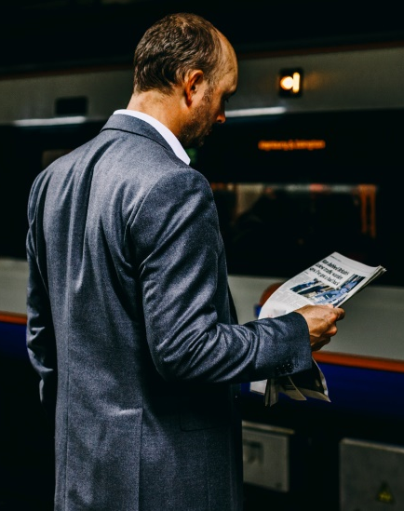
The Proposal:

Slide 10

Improvements:

